Slide 1
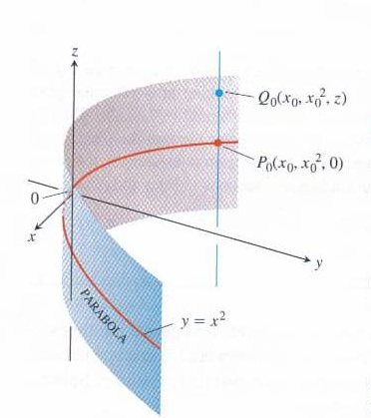
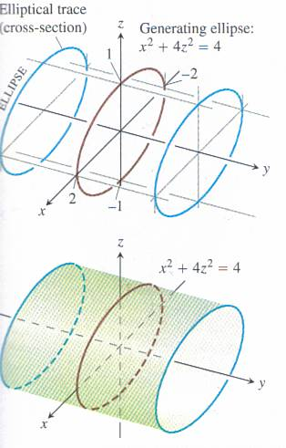
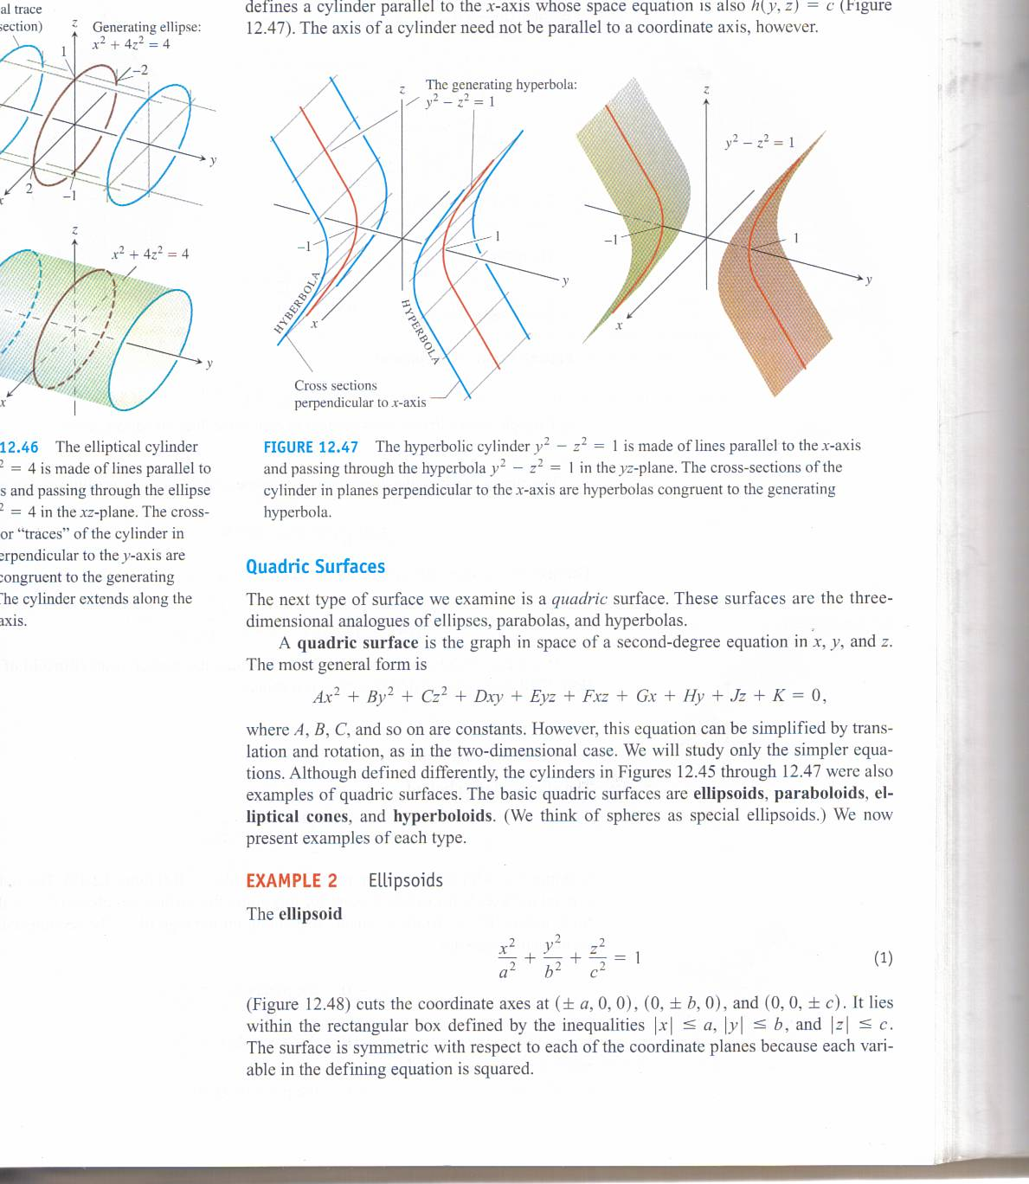
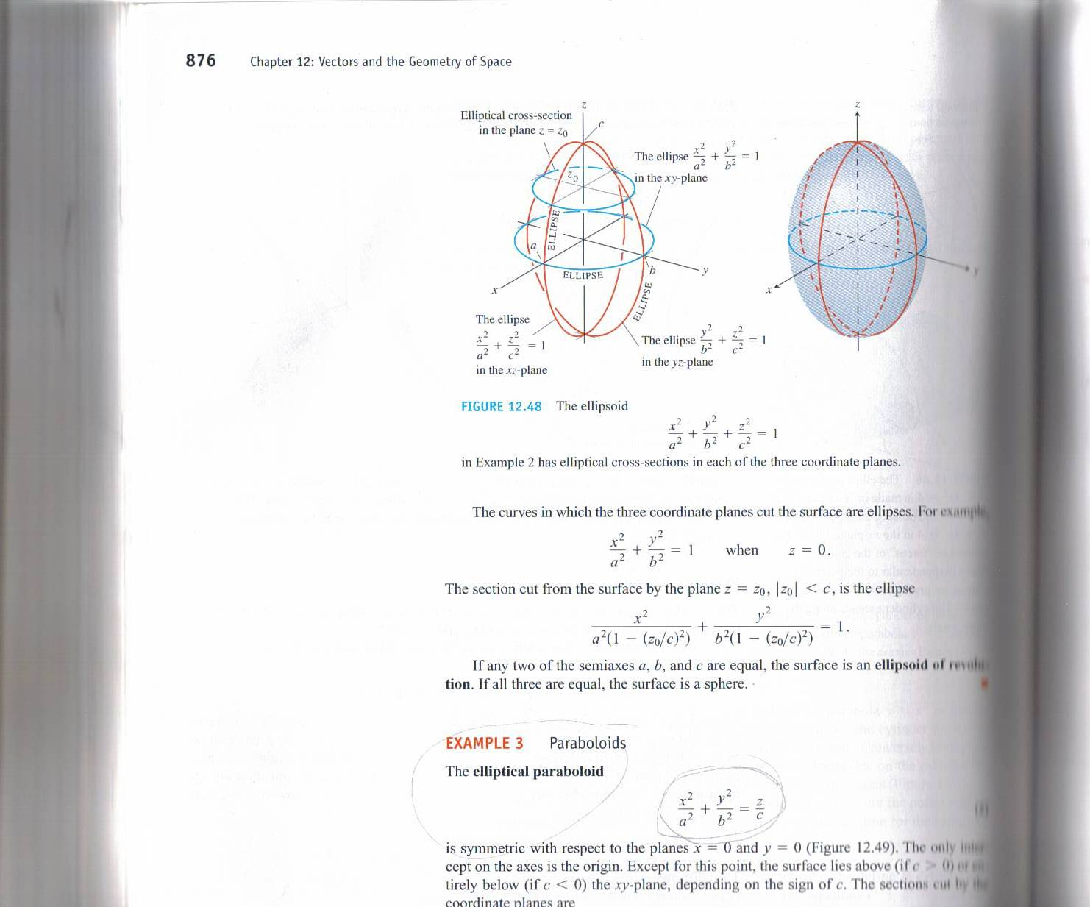
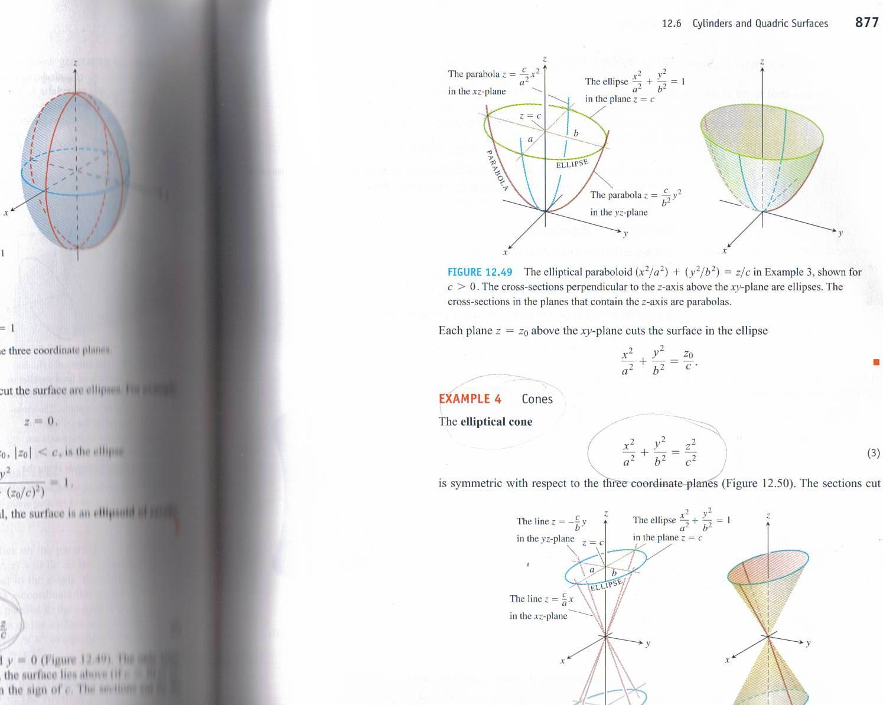
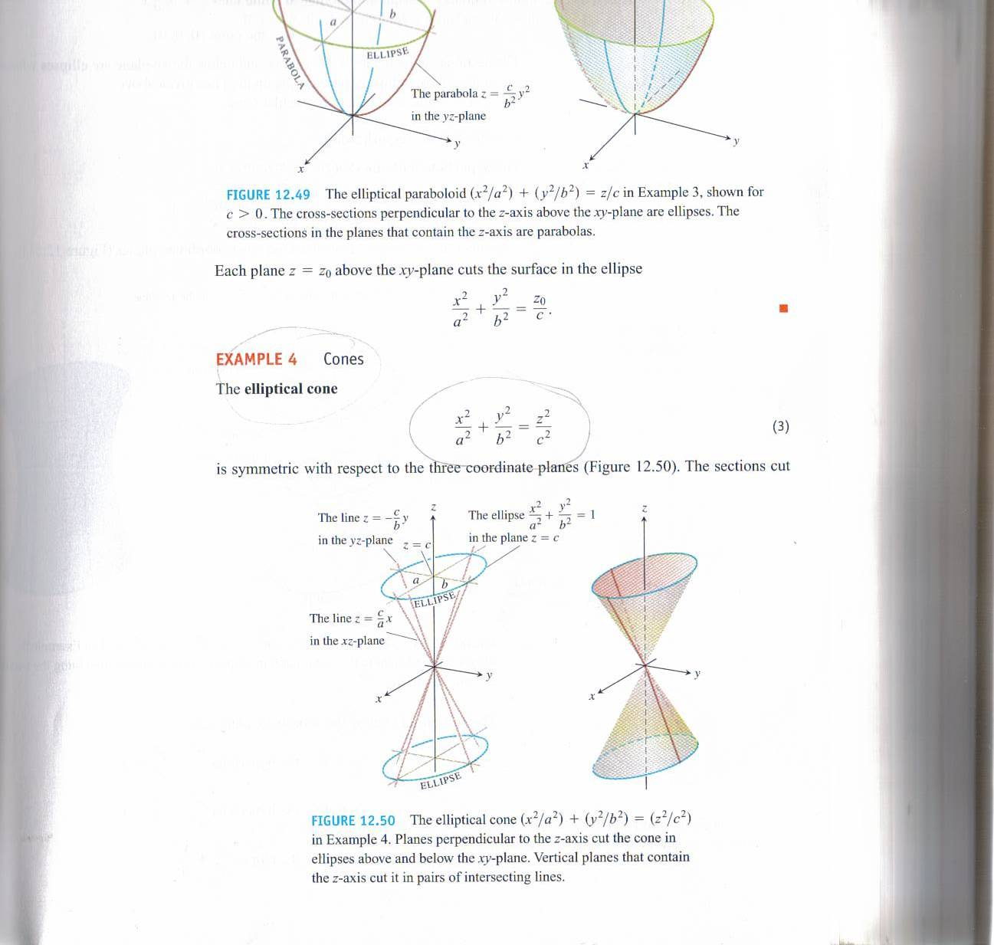
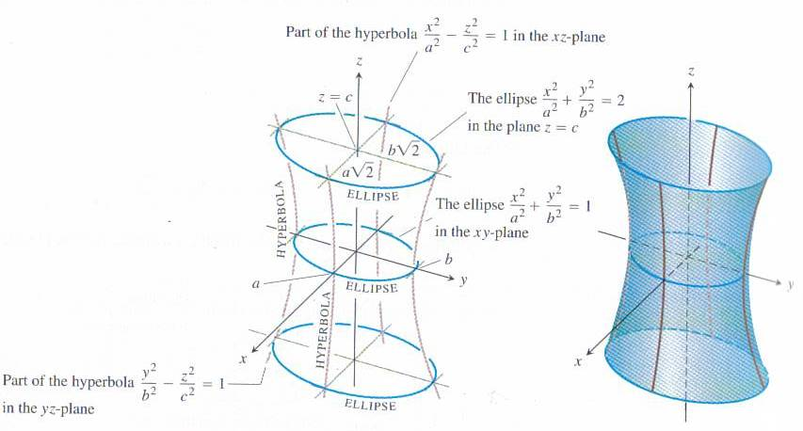
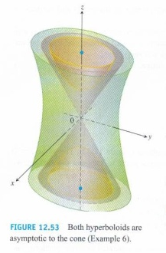

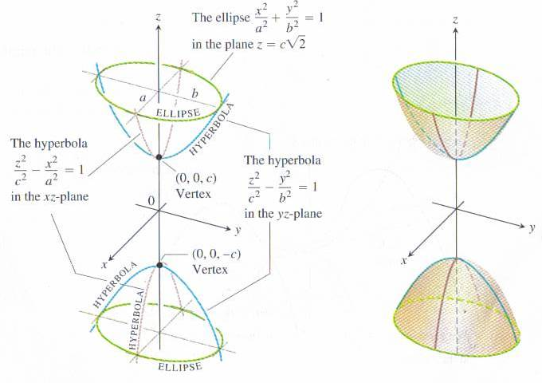
Quadratic Surfaces
Calculus III – Thomas Chapter 12 Section 6
Quadratic Surfaces – General Form: Ax² + By² + Cz² + Dxy + Eyz +Fxz + Gx + Hy + Jz + K = 0
R. M. E. Revised 2-25-07
Parabolic Cylinder
y = x²
Eliptical Cylinder
x² + 4z² = 4
Hyperbolic Cylinder
y² –z² = 1
Ellipsoid
Elliptical Paraboloid
x² ₊ y² ₊ z² ₌ ₁ a² b² c²
x² ₊ y² ₌ ₁ a² b²
Elliptical Cone
Hyperboloids
Hyperbolic Paraboloid (with saddle point
x² ₊ y² ₌ z² a² b² c²
y² – x² ₌ z b² a² c
Hyperboliod of one sheet
x² ₊ y² – z² ₌ ₁ a² b² c²
asymptotic to eliptical cone
Hyperboliod of two sheets
z² – x² – y² ₌ ₁ c² a² b²

